Slide 1
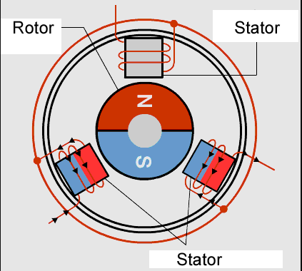
Bldc motor
A simple example of 3 phase motor.
One permanent magnet(Rotor)
3 iron cores which can be magnetized by passing current

Slide 2
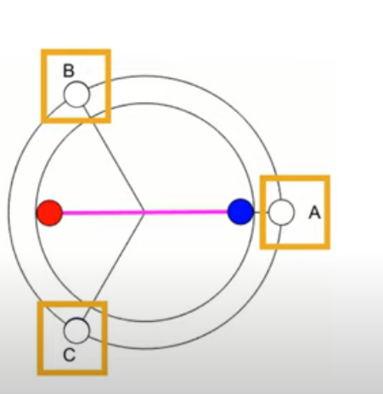
Representation
Three phases A, B, C
Red indicating north pole and blue south pole of rotor.

Slide 3
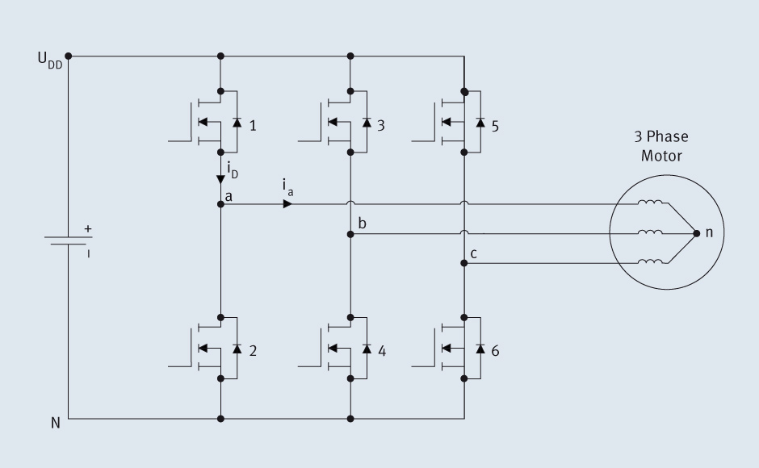
How the phases are connected ?
The phases are connected through a 3-phase inverter to a constant voltage supply.
Phase A
Phase B
Phase C
Three phase inverter

Slide 4
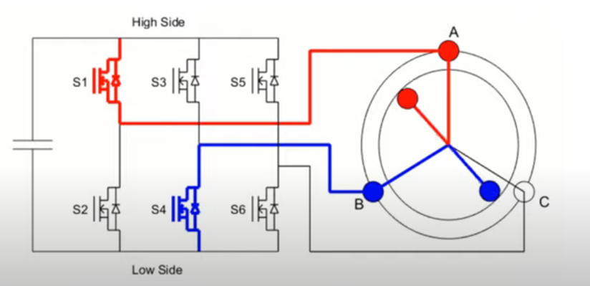
The inverter
We will be receiving a constant voltage to the inverter.
The current through the windings is controlled by H-bridges.
We use 6 H-bridges as below.
On flipping the,
> high side – phase is ‘N’ magnetized
> low side – phase is ‘S’ magnetized
Here constant voltage, S1(H bridge), phase A’s coil, phase B’s coil and S4(H bridge) form a circuit.
Enabling different H-bridges activates
different phases.

Slide 5
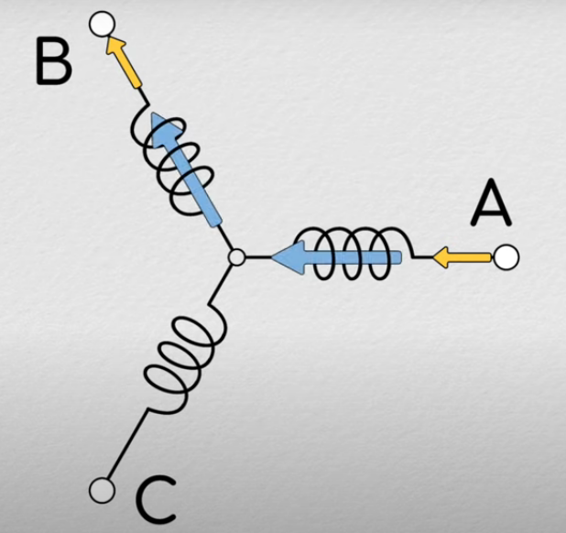
Current analysis and inverter
Here in 2nd picture golden arrow indicates direction of current and blue arrow the magnetic field induced due to current in the coils of the stator (i.e phase A or B or C).
Therefore, on closing switch S1 and S4 the current flows into A and comes out of B. in this way the circuit is completed.
Hence, A(red) is north and B(blue) is south with respect to the permanent magnet in the rotor. Next slide shows the phase activation pattern followed based on rotors position.
A
C
B

Slide 6
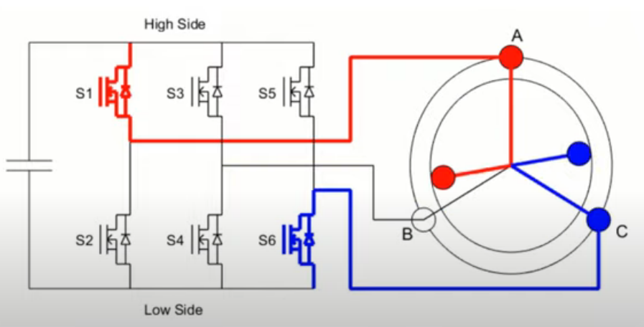
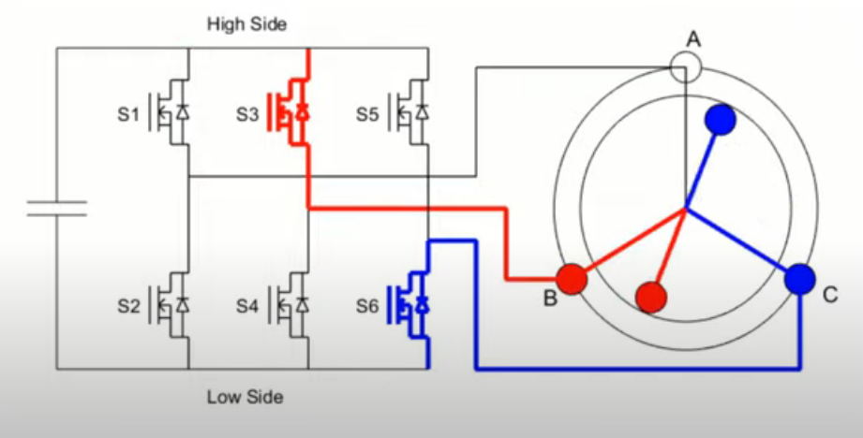
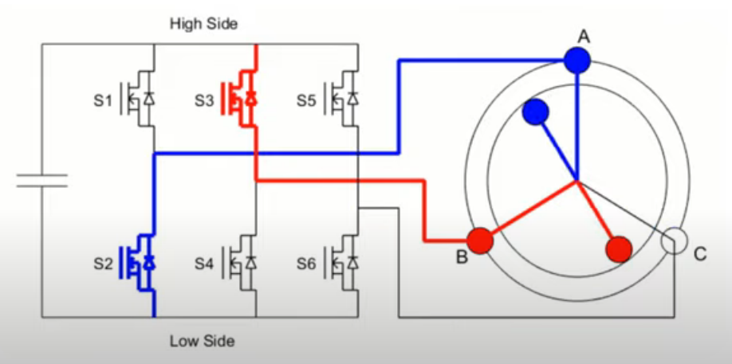
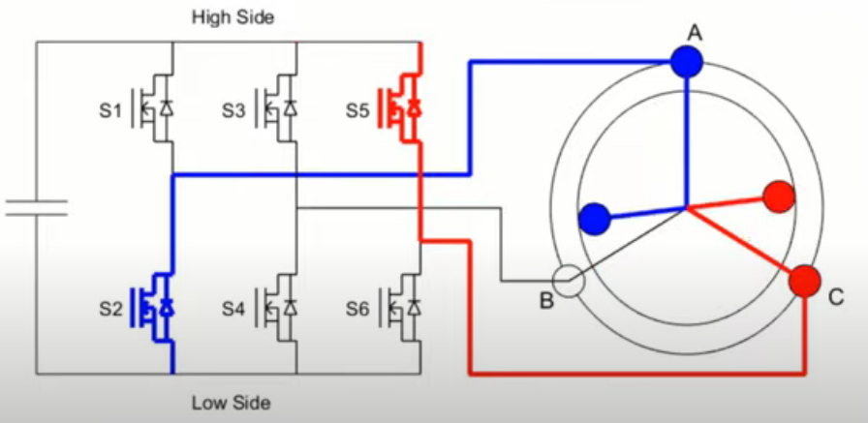
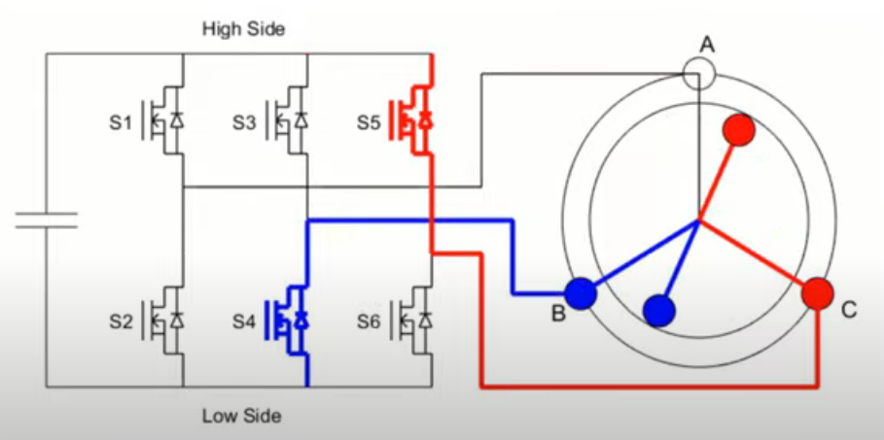

Slide 7
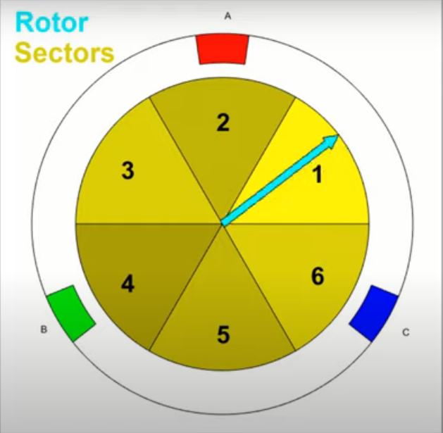
sectors
Based on possible phase activation patterns rotors position is divided into 6 sectors.
In order to rotate the rotor we need to magnetize the stators accordingly.
For example, lets say blue arrow indicates north pole of rotor. If it is in sector
1 – A : South , B : North , C : null
2 – A : null , B : South , C : North
3 – A : North , B : South , C : null
4 - A : North , B : null , C : South
5 – A : null , B : North , C : South
6 – A : South , B : North , C : null
A
B
C

Slide 8
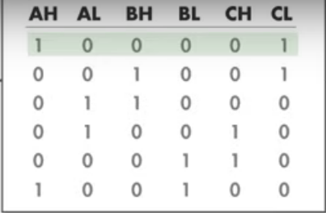
Automating commutation
The H-bridge switches which need to be closed depends on the position of rotor that is, in which sector the rotor is in.
So if we can detect the position of the rotor. We can come up with an algorithm to flip the switches based on the position.
To detect position of magnet we use hall sensors.
The algorithm is :
So now we need not flip the
switches. It is taken care by
the motor-controller with this
algorithm.
S1
S2
S3
S4
S5
S6
Sector 4
Sector 5
Sector 6
Sector 1
Sector 2
Sector 3

Slide 9
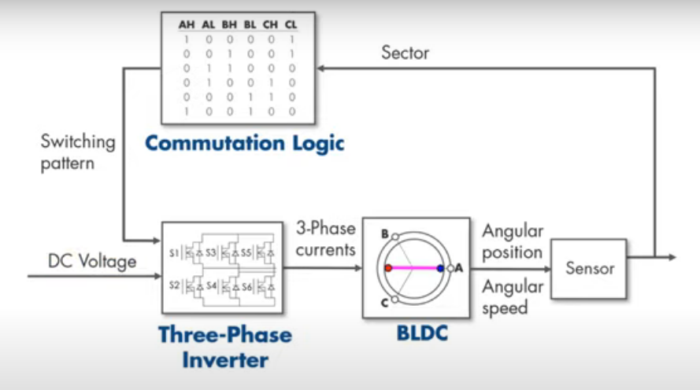
MatLab setup
The motor controller should have
Three phase inverter
Micro controller for implementing the switching pattern of the phases based on the position of rotor w.r.t sector ( position identified using hall sensors )

Slide 10
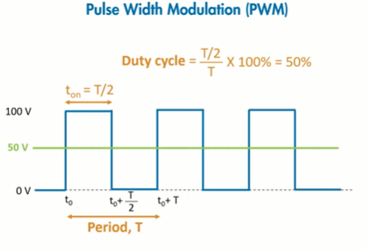
Speed control
Speed is controlled by changing the voltage supplied to the inverter. More the voltage, more the magnetic strength of coil, more the torque, hence more the speed assuming constant load.
This voltage change is done by PWM, A pulse width modulation.
Pulse width modulation is an averaging technique
In the below example the voltage constantly keeps changing periodically between 0 and 100V. it operates at high frequencies, this gives an averaging effect.
The average value depends on the duty cycle
In this case 50%, therefore averages to 50V.
This modulation is achieved by buck converter.

Slide 11
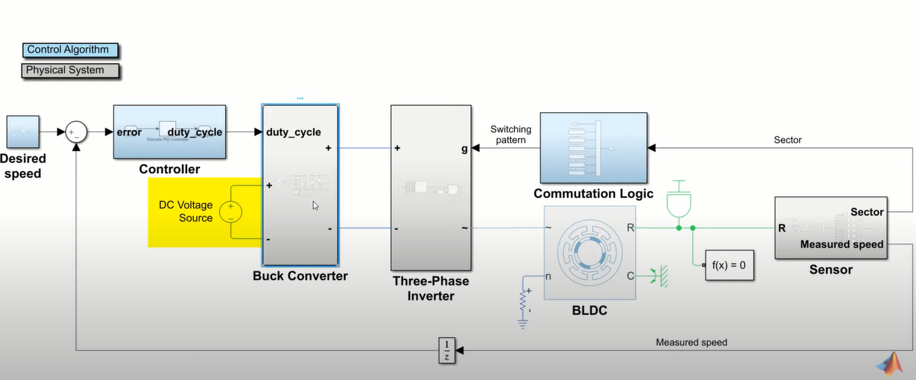
Matlab setup
Buck converter comes into play, to give in a variable voltage to the inverter, therefore controlling the speed
The buck converter takes duty cycle and voltage source as input. And gives voltage based on duty cycle. The final implementation is

